Slide 1
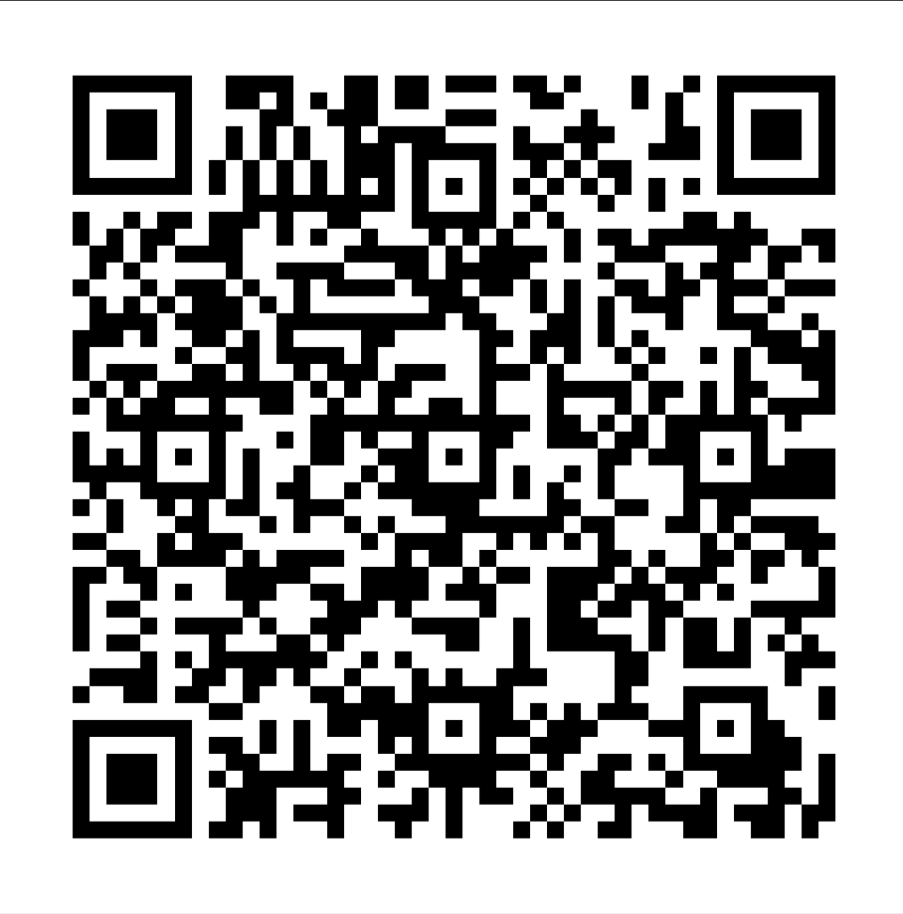
Mini Project-1 QR CODE GENERATOR Abstract
CHARAN RAJ 1602-20-737-009
GOURI MANASA 1602-20-737-014
SUHIDHAR 1602-20-737-048

Slide 2
Summary of the Project:
A QR code is used to provide easy access to online information through the digital camera on a smartphone or tablet . Quick Response (QR) codes seem to appear everywhere these days. We can see them on posters, websites, product packaging, online payment and many other. Using the QR codes is one of the most interesting ways of digitally connecting people to the internet via mobile phones since the mobile phones have become a basic necessity thing of everyone.
In this project, we present a methodology and generate QR codes for student details, where the users need to enter their details like name, roll no. After entering the details ,QR code is generated ,we can scan and see the output.

Slide 3
With this project, user will be able to:
Generate QR code for given details.
View and scan the generated QR code.
By scanning the QR code we can display the details of the student.
Download the generated QR.

Slide 4
Data Storage:
A file for storing generated QR codes.

Slide 5
GUI:
Entering details page and to display generated QR.

Slide 6
How our project is different?
Generation of QR is a application already found but in our project we are going to generate QR code for the student details entered and we are going to display the details when we scan the QR. And we are providing an option to save the generated QR codes.

Slide 7
Future Scope:
As everything becoming online, it’s better and easy to store Student details online via QR codes. Writing student details on papers(records) or in word documents will take lot of time and lot of papers will be wasted rather if we store student details via QR code it is easy, better and time saving . And we can print the generated QR codes on the student Id cards, hall tickets etc.. . We hope that generation of QR codes for student details will be more successful as it is easy ,time saving and useful.

Slide 8
Thank you

